Slide 1
Linux File Permissions
Presented By: Aamir Taymoor

Slide 2
Permission Groups
File or directory has 3 user based permission groups:
Owner : Owner permission apply only to owner of file/directory
Group : Group permissions apply only to the group assigned to file/directory
All Users : All User permission apply to all other users of the on the system

Slide 3
Permission Types
Each file/directory has 3 basic permission types:
read User can only read the file contents
write User can write or modify a file or directory
execute affects user’s capability to execute a file or view contents of directory

Slide 4
Viewing Permissions
“ls -l” command is used to view the permissions for the files/directories.
Permission in terminal is displayed as _rwxrwxrwx 1
_ for permission rights of file
“d” for directory
First occurrence of “rwx” represents Owner permission rights
Second occurrence of “rwx” represents Group permission rights
Third occurrence of “rwx” represents All User permission rights
r - read permission
w - write or modify permission
x - execute permission for file and content viewing permission for directory
- for no permission
Integer at the last indicates number of hardlinks to the file.

Slide 5
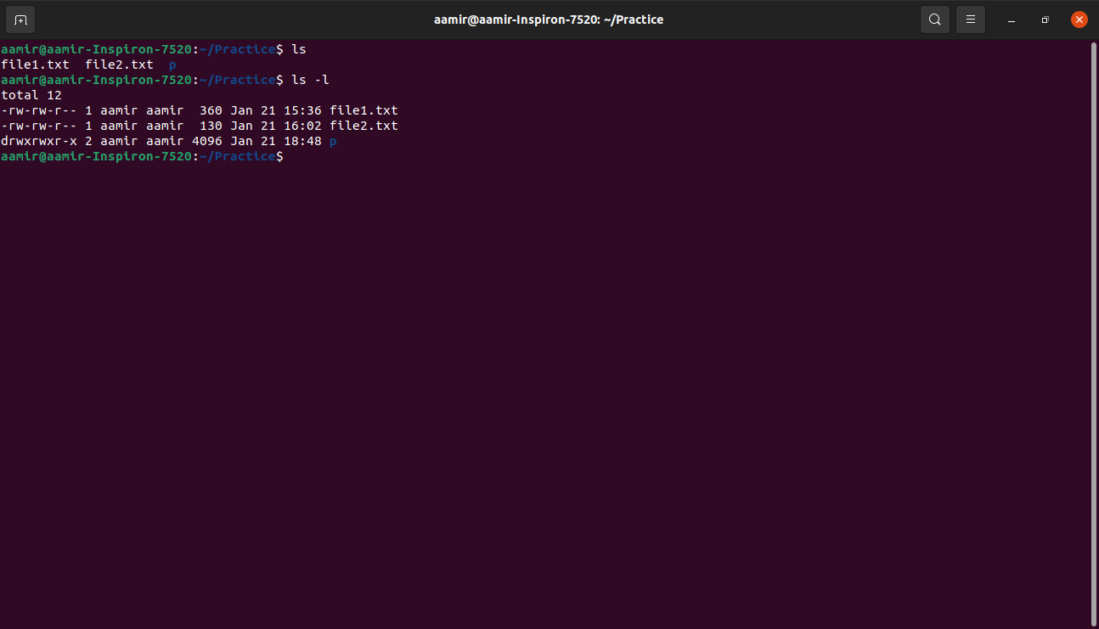

Slide 6
Modifying the Permissions
Permissions can be modified using the command chmod
Permissions can be modified in two ways:
Explicit permission assignment
Using binary references

Slide 7
Explicitly Assigning Permissions
Need to reference Permission Group and Permission Type
Permission Groups used are:
u - Owner
g - Group
o - Others
a - All Users
Assignment Operators are:
+ To add permissions
- To revoke permissions
Permission Types used:
r - Read
w - Write
e - Execute

Slide 8
Example
file1 with permissions set to _rw_rw_rw
Owner, Group and All Users have read and write permissions for the file1.
To revoke the permissions for all permission groups:
chmod a - rw file1
To add again the permissions for all permission groups:
chmod a +rw file1

Slide 9
Using Binary References to set Permissions
We use the chmod command with 3 integers and filename
chmod 640 file1
Owner
Group
All Users

Slide 10
Binary references contd…
The numbers are binary representation of rwx string:
r - 4
w - 2
x - 1
Add the numbers for each permission type to get the permission group number
To set the permission of _rwxr_____ for file1, use:
Chmod 740 file1
4 + 2 + 1 = 7
4+0+0= 4
0+0+0 = 0

Slide 11
Owners and Groups
To assign or change the Owner and Group to file or directory, use command
chown command.
chown Owner:Group filename
Eg To change the Owner of file1 to user1 and the Group to family:
chown user1:family file1

Slide 12
setuid/setgid Special Permissions
Setuid
setuid bit is present for files with executable permissions.
Sets execution permissions of file to owner instead of the user who launched it.
To locate, look for ‘s’ instead of ‘x’ in the Owner section of the file permissions.
Eg chmod u+s file1.txt
ls -l file1.txt
Output : -rwSrw-r-- 1 aamir aamir 360 Jan 21 15:36 file1.txt
To revoke setuid bit,
chmod u-s file1.txt
Setgid
setgid affects both file and directory.
When used on file, it executes with privileges of the group who is owner instead of the group who executed it.
When used on directory, the set of files in the directory will have same group as group of the parent directory
To locate, look for ‘s’ instead of ‘x’ in the Group section of the file permissions.
To set setgid bit use :
chmod g+s filename
To remove setgid bit use:
chmod g-s file

Slide 13
Sticky Bit Special Permissions
Very useful in shared environments
When sticky bit is set for directory, only the Owner can rename or delete a file from that directory.
Can only be set by explicitly defining permissions.
To set sticky bit on file1.txt use:
chmod +t file1.txt
To remove sticky bit on file1.txt use:
chmod -t file1.txt

Slide 14
When Permissions Are Important
Home directories:
We do not want users to view and modify other user’s home directories
For that, we want directory to have drwx______(700) permissions.
Eg to enforce such permissions for user1:
chmod 700 /home/user1
bootloader configuration files:
To implement password to boot specific operating systems, then we need to remove read and write permissions for configuration files for all users except root.
For that, change permissions of the file to 700.
System and daemon configuration files:
Such files need to be write protected
Set permissions to 644
Firewall scripts:
Necessary to protect users from writing to firewall script files.
Firewall script is run by root user automatically on boot.
All other users need no rights, set permissions to 700

Slide 15
Thank you

